Slide 1
Control Engineering
Lecture 13
MIMO systems

Slide 2
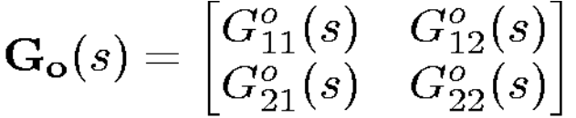
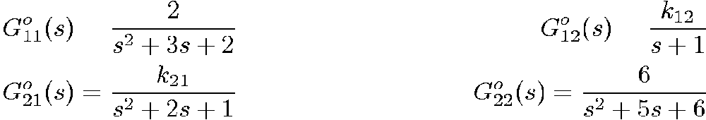
Decentralized control
Consider a two-input, two-output plant having the transfer function

Slide 3
Decentralized control
Let us say that k₁₂ and k₂₁ depend on the operating point (a common situation, in practice).
Operating point 1 (k₁₂ = k₂₁ = 0)
Clearly, there is no interaction at this operating point.
Thus, we can safely design two SISO controllers. To be specific, say we aim for the following complementary sensitivities:

Slide 4
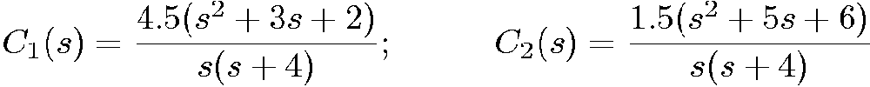
Decentralized control
The corresponding controller transfer functions are C₁(s) and C₂(s), where
The two independent loops perform as predicted.

Slide 5
Decentralized control
Operating point 2 (k₁₂ = k₂₁ = 0.1)
With the previously designed controller we apply a unit step in the reference for output 1 at t = 1 and a unit step in the reference for output 2 at t = 10. The closed-loop response is shown on the next slide. These results would probably be considered very acceptable, even though the effects of coupling are now evident in the response.

Slide 6
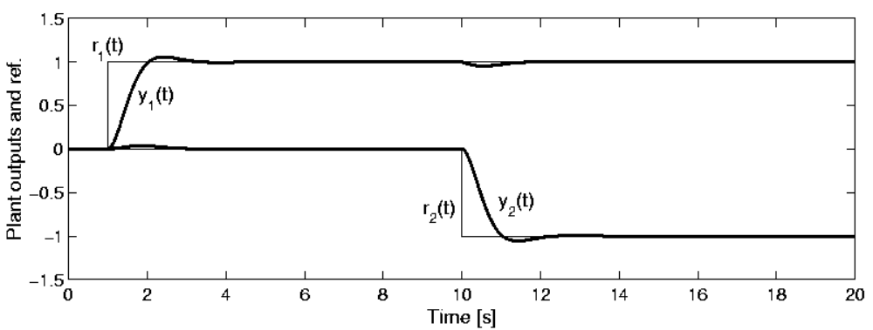
Effects of weak interaction in control loop with SISO design

Slide 7
Decentralized control
Operating point 3 (k₁₂ = -1, k₂₁ = 0.5)
With the same controllers and for the same test as used at operating point 2, we obtain the results on the next slide.
We see that a change in the reference in one loop now affects the output in the other loop significantly.

Slide 8
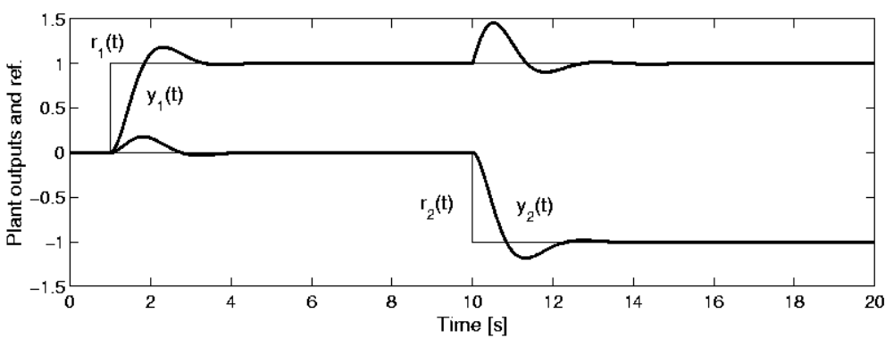
Effects of strong interaction in control loops with SISO design

Slide 9
Decentralized control
Operating point 4 (k₁₂ = -2, k₂₁ = -1)
Now a simulation with the same reference signals indicates that the whole system becomes unstable. We see that the original SISO design has become unacceptable at this final operating point.

Slide 10
Pairing of Inputs and Outputs
If one is to use a decentralized architecture, then one needs to pair the inputs and outputs. In the case of an m × m plant transfer function, there are m! possible pairings. However, physical insight can often be used to suggest sensible pairings.
Notes:
<<<21.3>>>
### Pairing of Inputs and Outputs###

Slide 11

Relative Gain Array
One method that can be used to suggest pairings is a quantity known as the Relative Gain Array (RGA). For a system with matrix transfer function G_{o}(s), the RGA is defined as a matrix Λ with the ij^{th} element
where [G_{o}(0)]_{ij} and [G_{o}⁻¹(0)]_{ij} denote the ij^{th} element of the plant d.c. gain and the ji^{th} element of the inverse of the d.c. gain matrix respectively.

Slide 12
Relative Gain Array
Note that [G_{o}(0)]_{ij} corresponds to the d.c. gain from the i^{th} input, u_{i}, to the j^{th} output, y_{j}, while the rest of the inputs, u_{l} for l ∈{1, 2, …, i-1, i+1, …, m} are kept constant. Also [G_{o}⁻¹]_{ij} is the reciprocal of the d.c. gain from the i^{th} input, u_{i}, to the j^{th} output, y_{j}, while the rest of the outputs, y_{l} for l ∈{1, 2, …, j-1, j+1, …, m} are kept constant. Thus, the parameter λ_{ij} provides an indication of how sensible it is to pair the i^{th} input with the j^{th} output.

Slide 13

Relative Gain Array
One usually aims to pick pairings such that the diagonal entries of Λ are large. One also tries to avoid pairings that result in negative diagonal entries in Λ.
For a 2 x 2 system RGA is

Slide 14
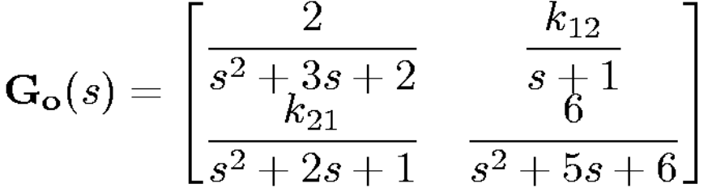
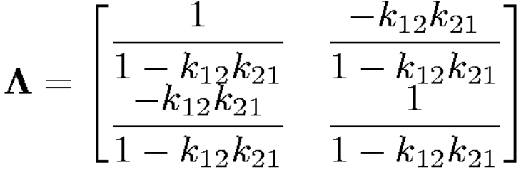
Relative Gain Array
Consider again the system
The RGA is then

Slide 15
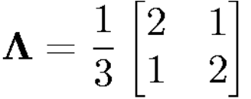
Relative Gain Array
For 1 > k₁₂ > 0, 1 > k₂₁ > 0, the RGA suggests the pairing (u₁, y₁), (u₂, y₂). We recall from our earlier study of this example that this pairing worked very well for k₁₂ = k₂₁ = 0.1 and quite acceptably for k₁₂ = -1, k₂₁ = 0.5. In the latter case, the RGA is

Slide 16
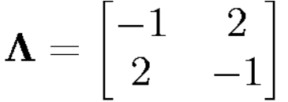
Relative Gain Array
However, for k₁₂ = -2, k₂₁ = -1 we found that the centralized controller based on the pairing (u₁, y₁), (u₂, y₂) was actually unstable. The corresponding RGA in this case is
which indicates that we probably should have changed to the pairing (u₁, y₂), (u₂, y₁).

Slide 17
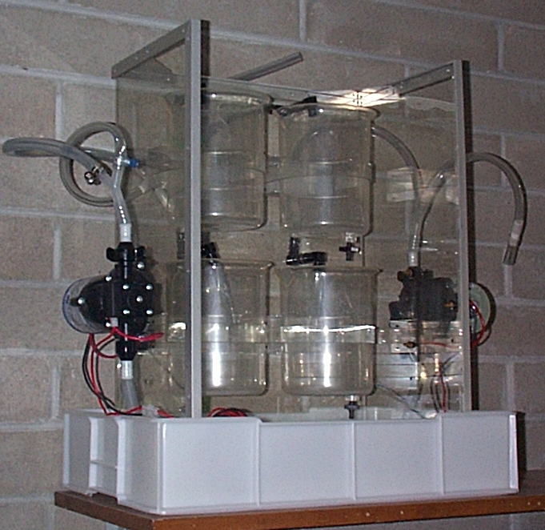
Example
Quadruple-tank apparatus

Slide 18
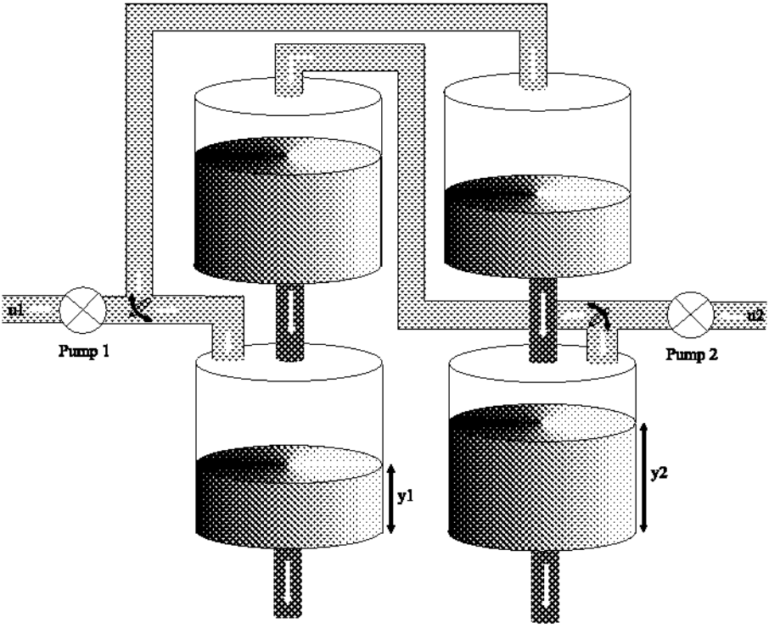
Example

Slide 19
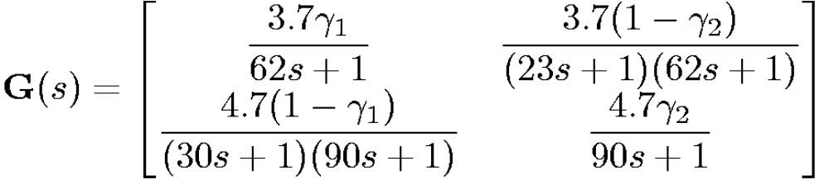
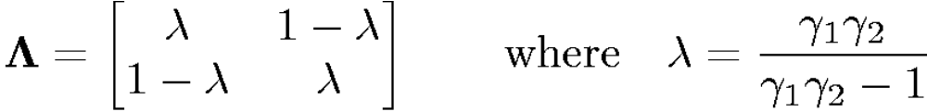
Example
This system has an approximate transfer function
The RGA for this system is

Slide 20
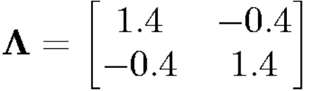
Example
For 1 < γ₁ + γ₂ < 2 the system is of minimum phase. If we take, for example, γ₁ = 0.7 and γ₂ = 0.6, then the RGA is
This suggests that we can pair (u₁, y₁) and (u₂, y₂).

Slide 21
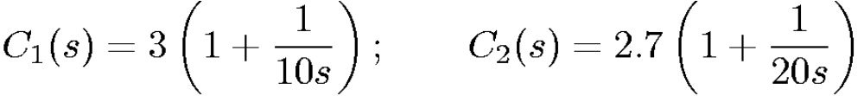
Example
Because the system is of minimum phase, the design of a decentralized controller is relatively easy in this case. For example, the following decentralized controller gives the results shown on the next slide

Slide 22
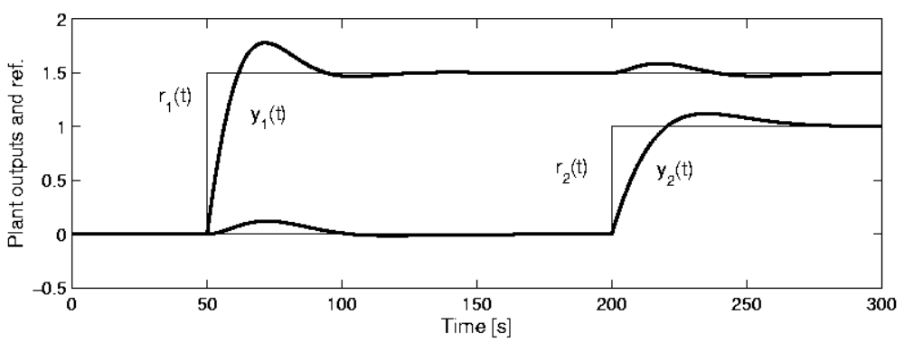
Decentralized control of a minimum-phase four-tank system

Slide 23
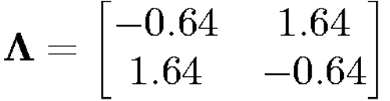
Example
For 0 < γ₁ + γ₂ < 1, the system is nonminimum phase. If we take, for example γ₁ = 0.43 and γ₂ = 0.34, then the system has a NMP zero at s = 0.0229, and the relative gain array becomes

Slide 24
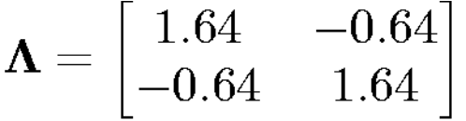
Example
This suggests that (y₁, y₂) should be commuted for the purposes of decentralized control. This is physically reasonable, given the flow patterns produced in this case. This leads to a new RGA of

Slide 25
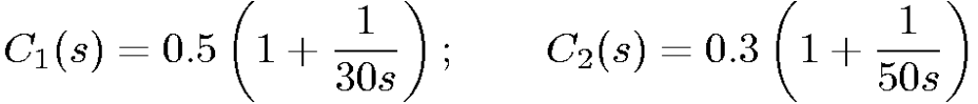
Example
Note, however, that control will still be much harder than in the minimum-phase case. For example, the following decentralized controllers give the results shown on the next slide.

Slide 26
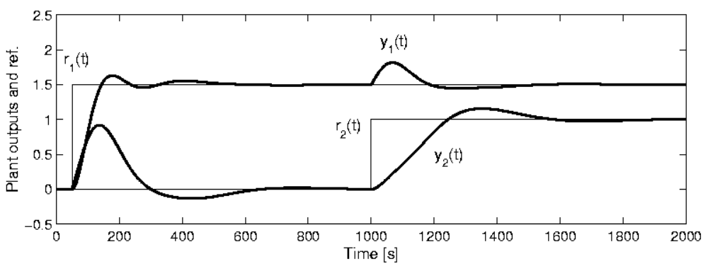
Decentralized control of a nonminimum- phase four-tank system

